Slide 1
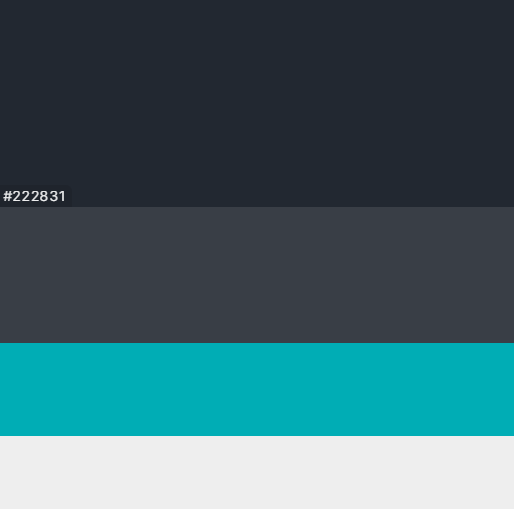












Slide 2


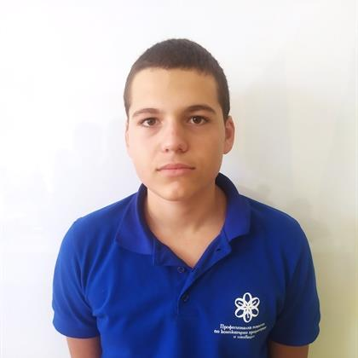
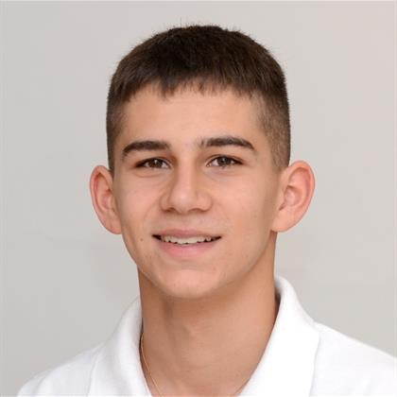
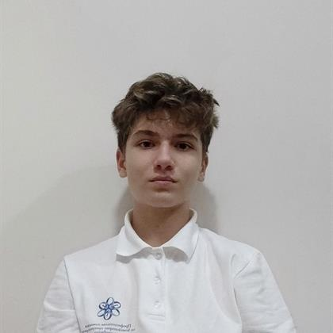
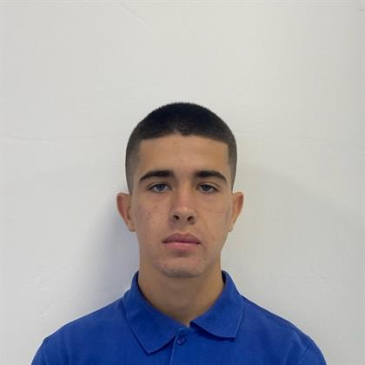
Our team
Todor Yordanov Atanasov
Ivan Doychinov Dochev
Scrum trainer
Back-end developer
Aleks Zdravkov Kazakov
Martin Todor Nenkov
Back-end developer
Front-end developer

Slide 3



The plan!

Slide 4











Used Technologies

Slide 5
Thanks for the attention!
Let’s jump to the code!

